Slide 1


MASS MAIL DISPATCHER
NAME : SOWMIYA S
DEPARTMENT :INFORMATION TECHNOLOGY (2ND YEAR)
COLLEGE : VELAMMAL COLLGE OF ENGINEERING AND TECHNOLOGY

Slide 2
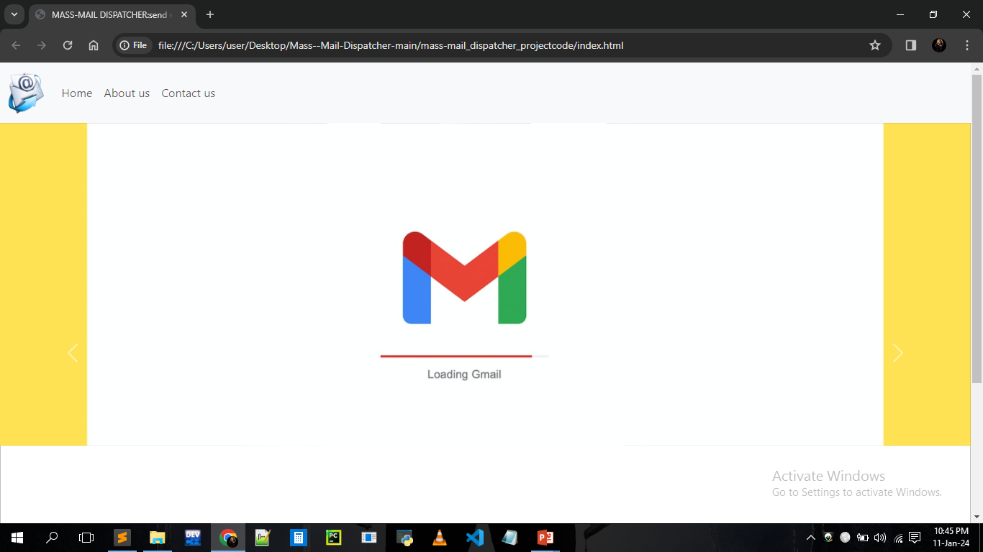
INDEX PAGE

Slide 3
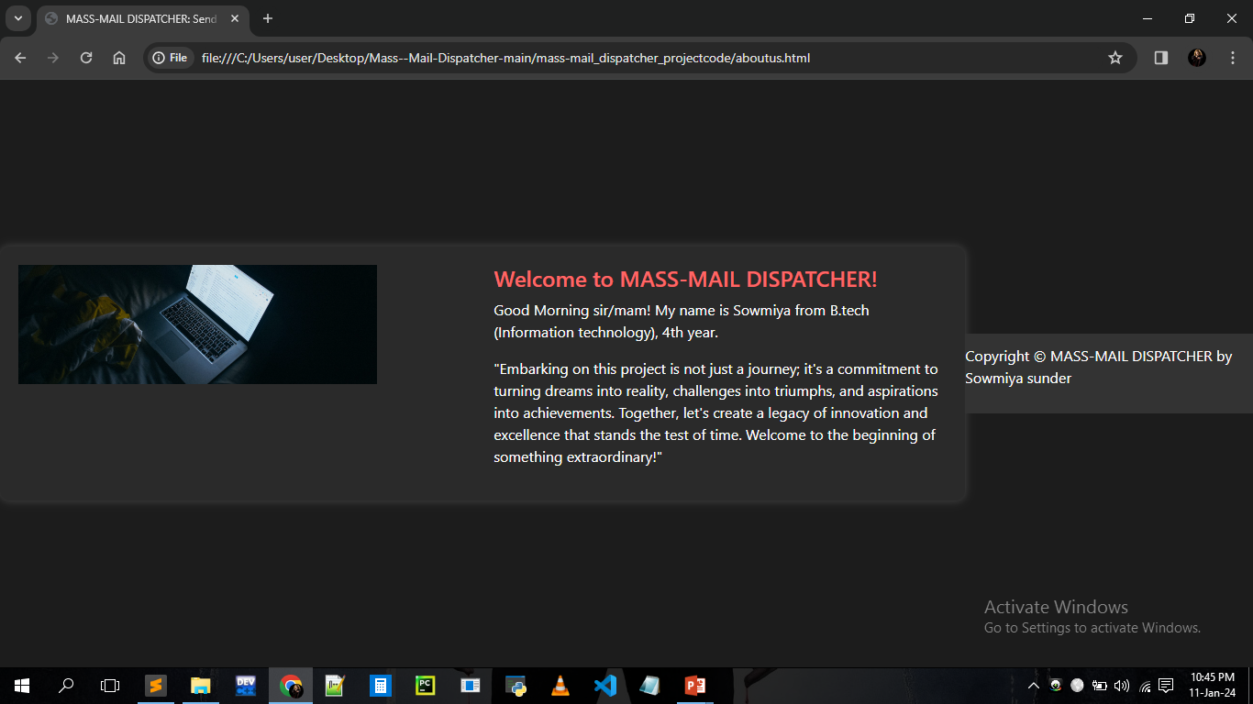
ABOUT US PAGE

Slide 4
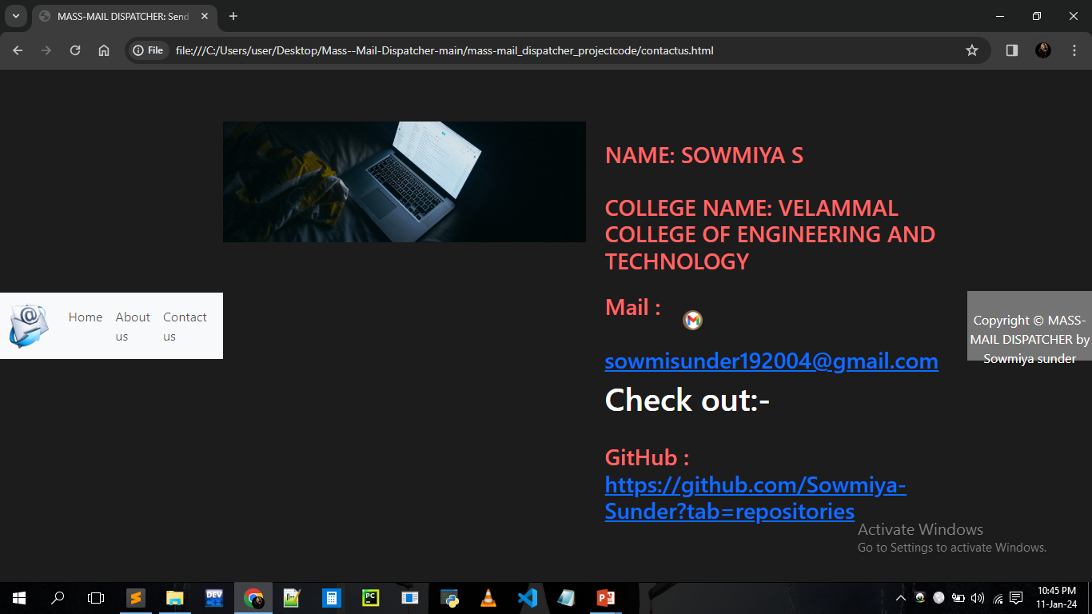
CONTACT US PAGE

Slide 5
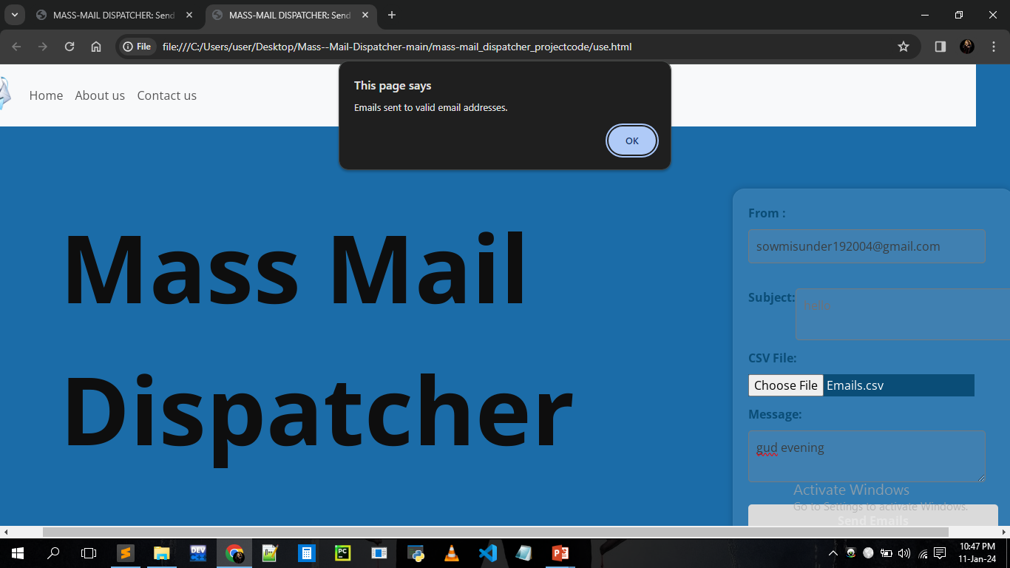
MASS MAIL DISPATCHER

Slide 6

Thank You!

